Slide 1


EMPLOYEE
ENGAGEMENT
User guide to the Employee Engagement reporting platform
Copyright © by Ennova

Slide 2
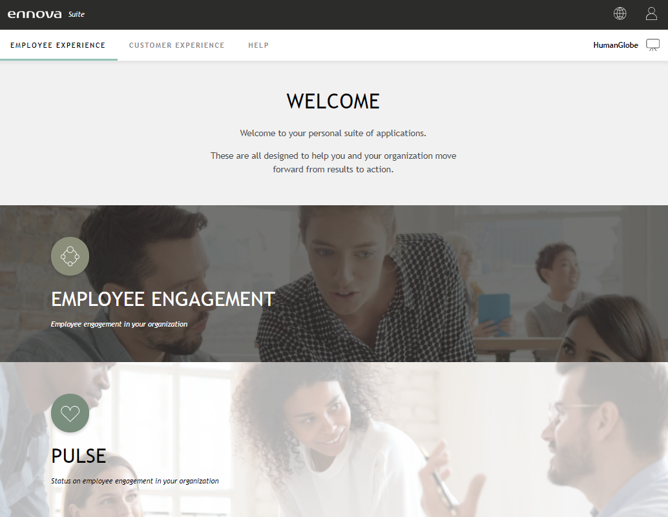
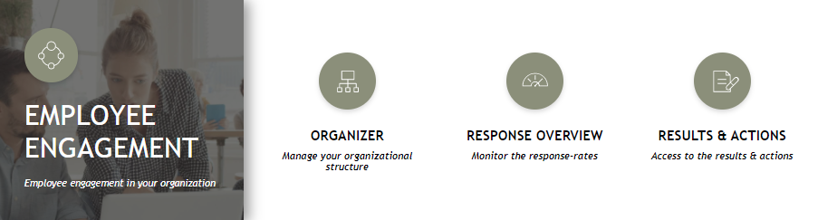
ACCESSING THE RESULTS
Go to Ennova Suite to access the results
Go to the Employee Engagement ribbon and access ‘results & action’

Slide 3
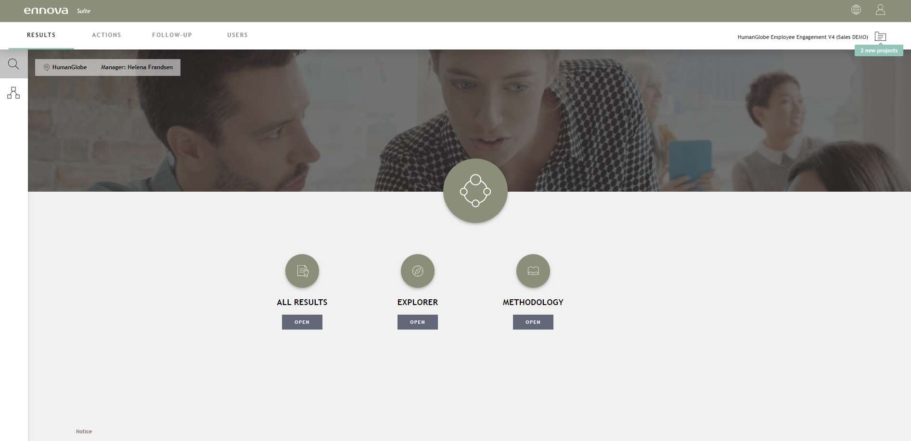
NAVIGATION
Access the different units you have access to by clicking the tree structure. Select the unit of interest.
Access the Employee Engagement reporting platform by clicking “All Results”

Slide 4


INFORMATION & GUIDANCE IN the Employee engagement platform
On all pages in the report, the user has access to information about the specific page and content
Information
When holding the mouse over the information icon, it will turn green and a tooltip with the word ‘Information’ will appear

Slide 5
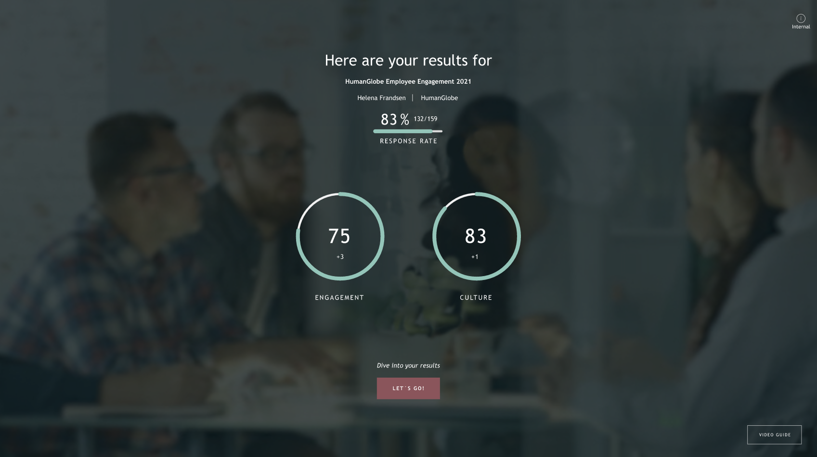
WELCOME
Response rate, Team name, immediate manager and key Engagement KPI’s results available on the welcome page.
Go to the results
Click to see video guide

Slide 6
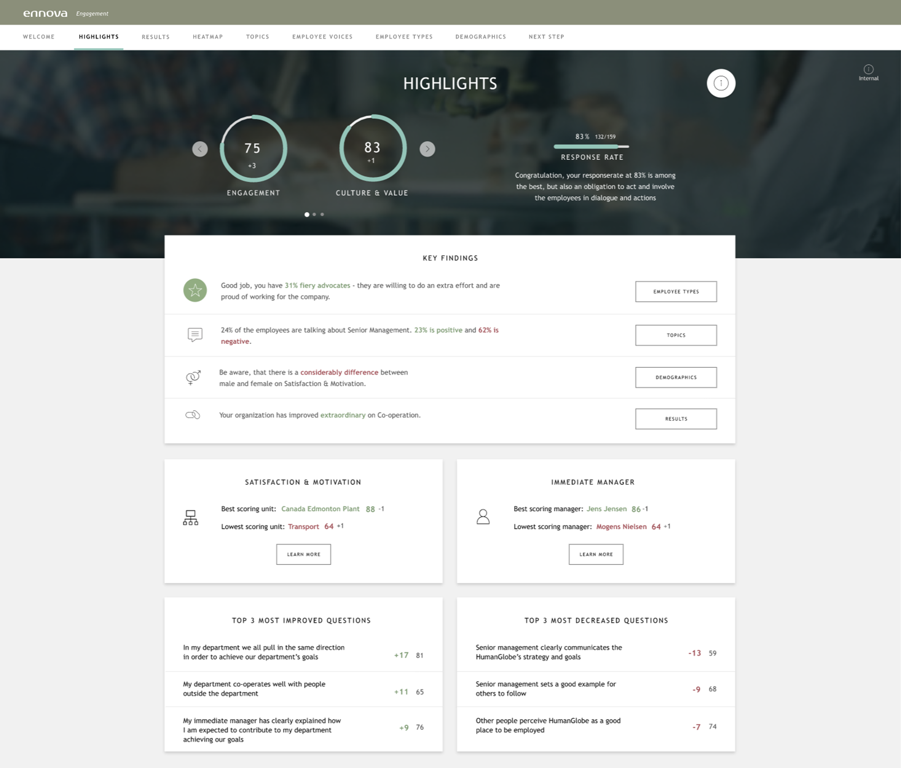
HIGHLIGHTS
The highlight section aims at helping the managers quickly understand the most important results in their team and across their organization.
The highlight section include key findings based on the specific unit's data. Key findings in the specific unit can be:
Low/high scores compared to benchmark
Most increased/decreased questions
High level of disagreement
Demographic results
Leadership evaluations
Specific results - e.g., collaboration, respect & trust, feedback and workload etc.
Segmentation of employees
Text analytics (if included).
The rank of key findings is defined based on many years of experience and knowledge - and to ensure that all teams gets the most relevant highlights from their survey results.

Slide 7
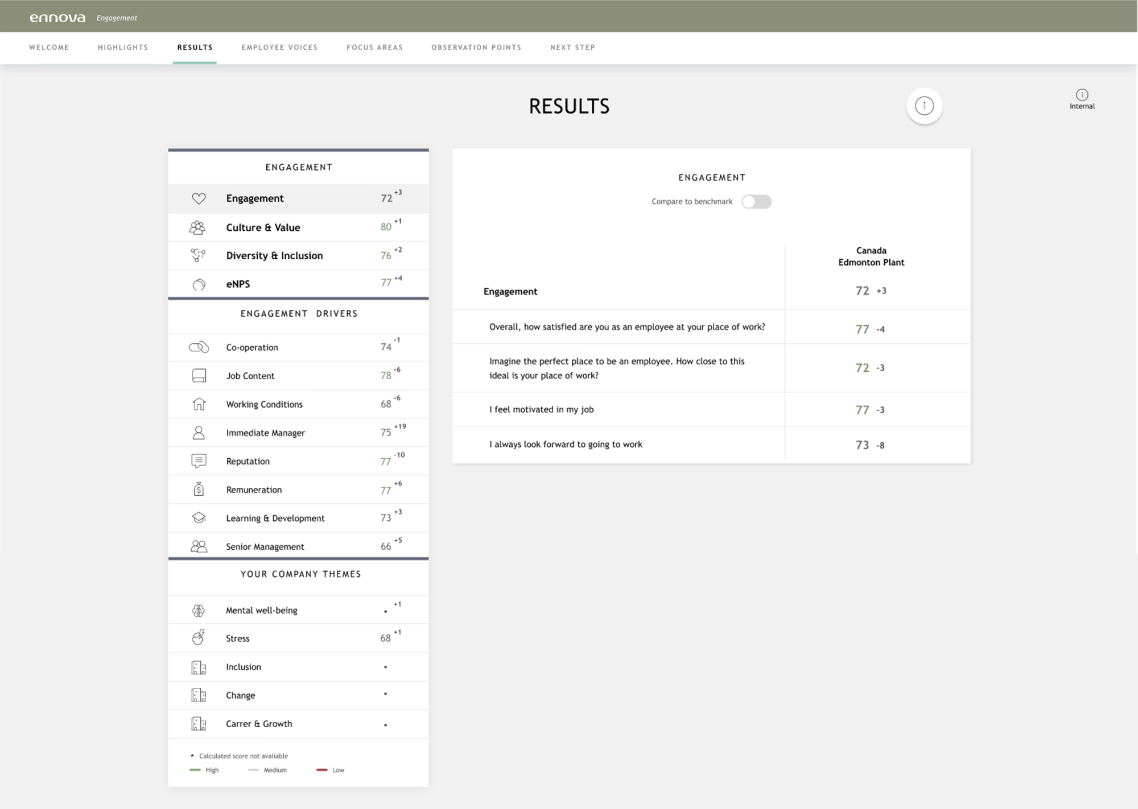
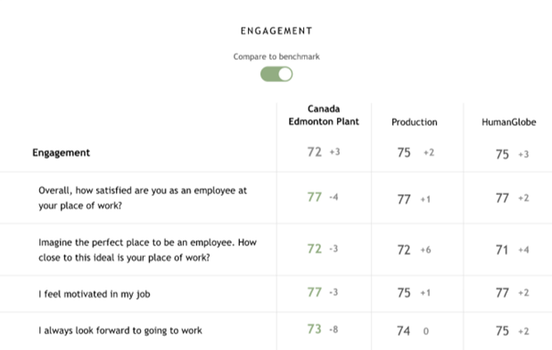
RESULTS
See all your results for each theme compared to benchmark. Click on a theme to see the underlying questions and their results.
Engagement – is the overall engagement drivers and your organization key KPI’s
Engagement Drivers – is the drivers from Ennova’s GELx model
Your Company Themes – is customer specific themes that you have included in your engagement survey
Results coloured (green>=75, grey=60-75, red<60)
High level of disagreement (variation) in the employees responses marked with two arrows
Compare your results to the available benchmarks

Slide 8
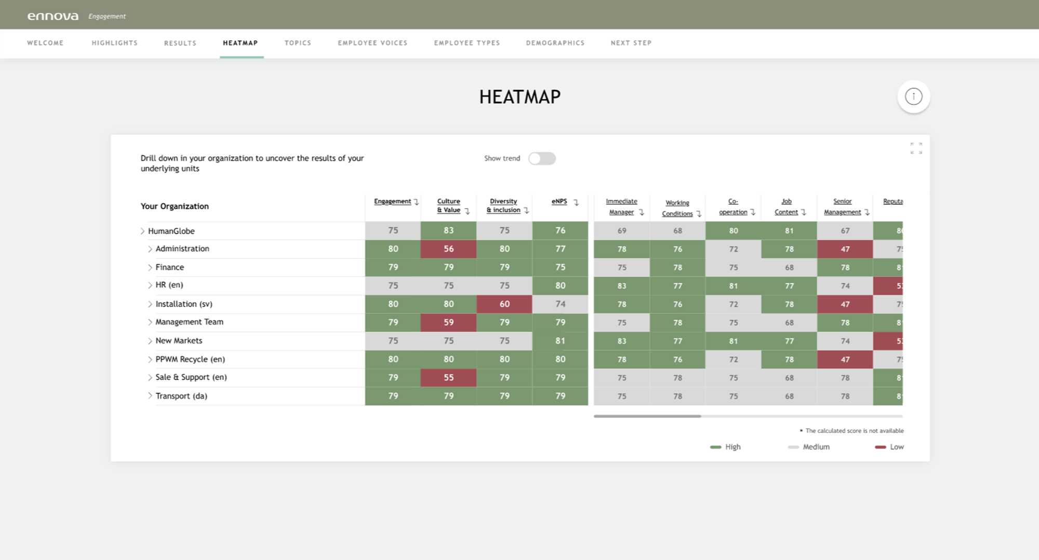
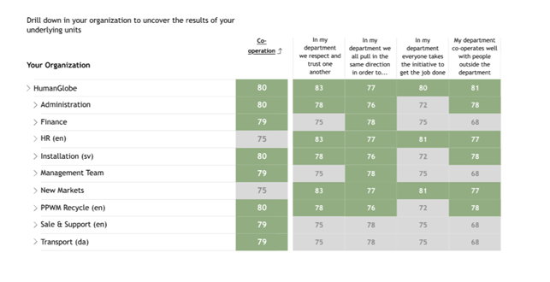
HEATMAP
Show development in the overview
Click on a theme to see the scores on question level
Get the full organizational overview. See Engagement KPI’s, Engagement Drivers and your company specific themes.
Only available in higher level reports.
Navigate down in the organization to see results.

Slide 9
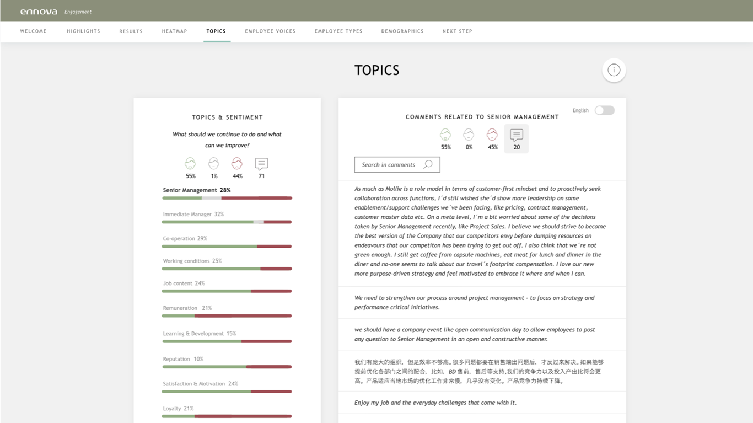
TOPICS
Search for specific key words in the comments
Filter the comments by clicking on the icon for negative, neutral or positive comments
Translate the comments into English
Ennova’s advanced algorithm has categorized the comments from your organization into selected topics.
Navigate between the comments by clicking on a theme.
Only available in higher level reports with minimum 50 open comments.

Slide 10
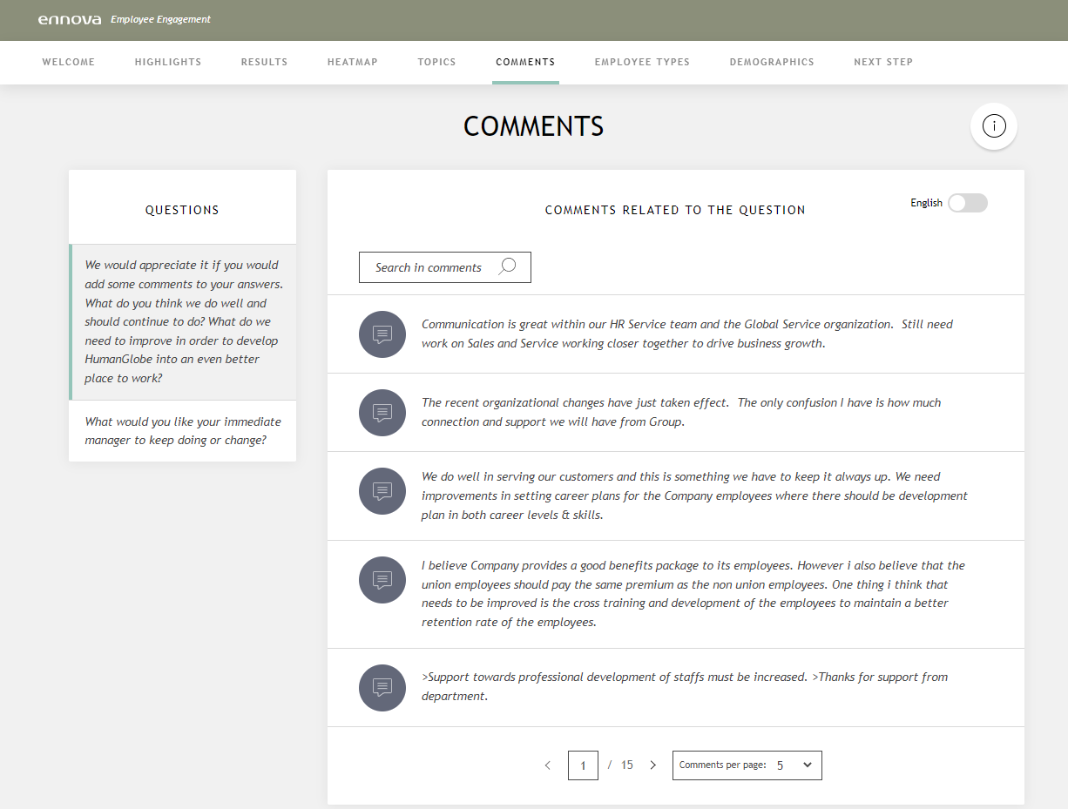
EMPLOYEE VOICES
If multiple open ended questions in your survey, you can navigate between these in the menu to the left
Search for specific key words in the comments
Translate the comments into English
Get valuable insight from the comments provided by the employees in your organization or team.
Choose how many comments you would like to see per page

Slide 11
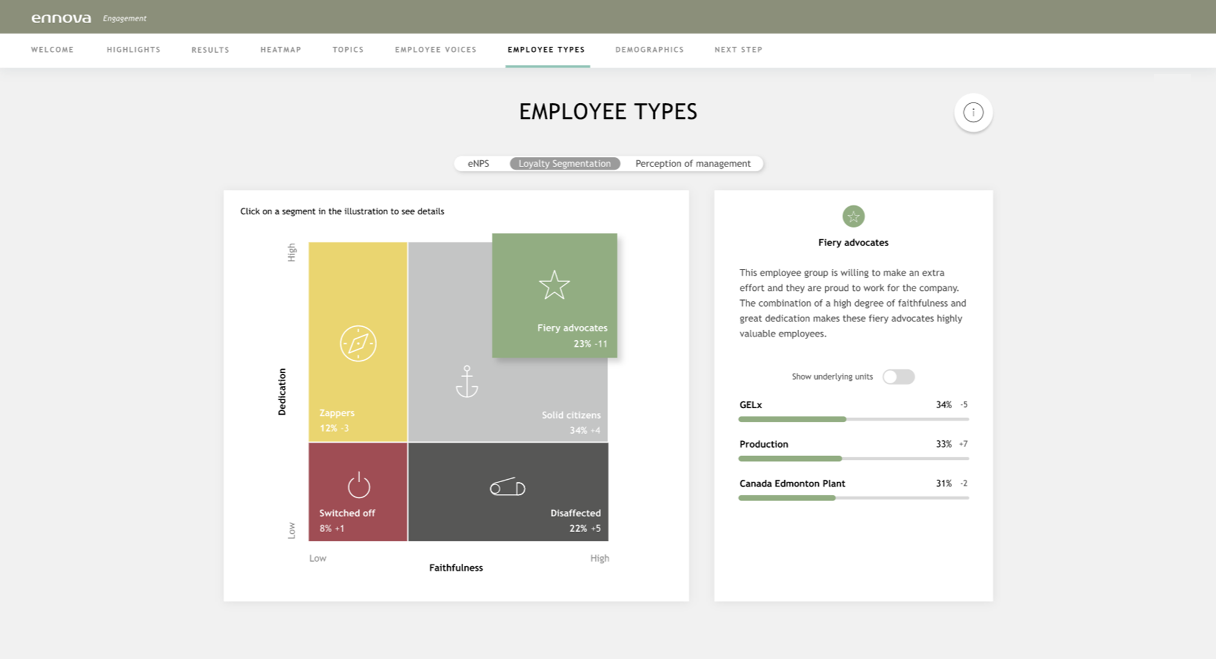
EMPLOYEE TYPES
Navigate between available employee types such as eNPS, Loyalty segmentation and Perception of management
Find information about the employee types in your organization or team.
Click on a segment in the illustration to see details.
eNPS = employee net promoter score Indicate Employer Brand strength in terms of proportion of Promoters and Detractors.
Show results for underlying units if available

Slide 12
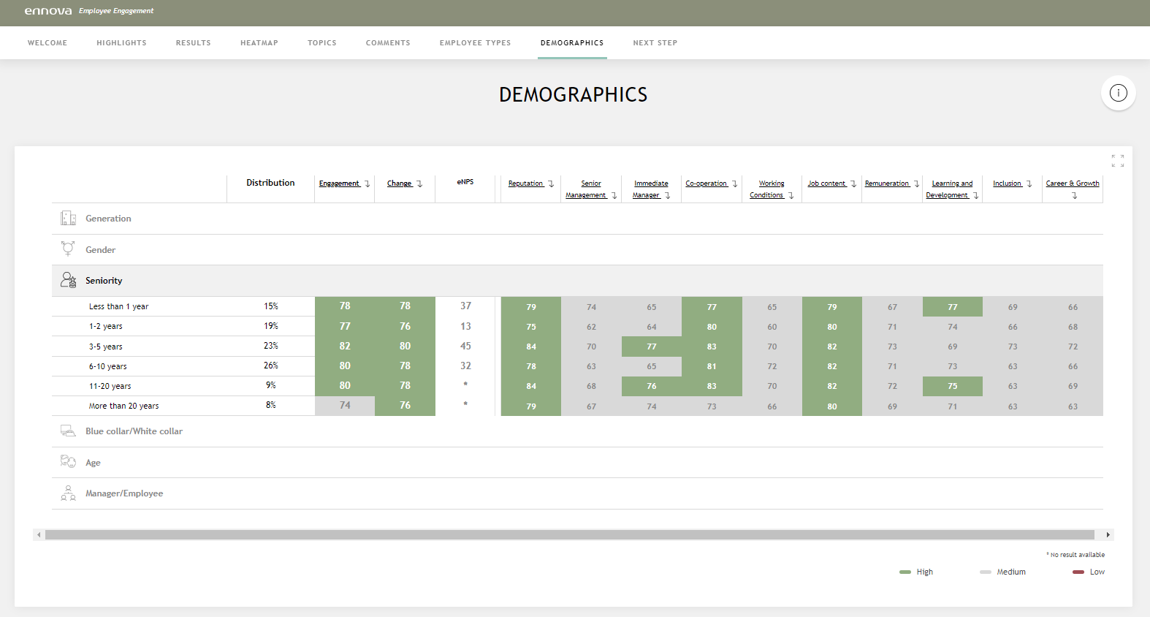
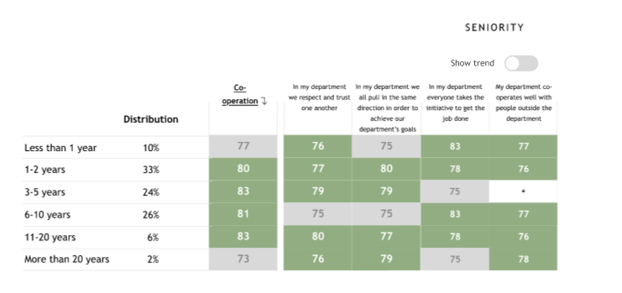
DEMOGRAPHICS
The distribution of employees according to selected demographics. Click on ‘show more’ to see the results of the different demographics.
Only available in higher level reports with more than 99 responses.
Click on a theme to see the scores on question level

Slide 13
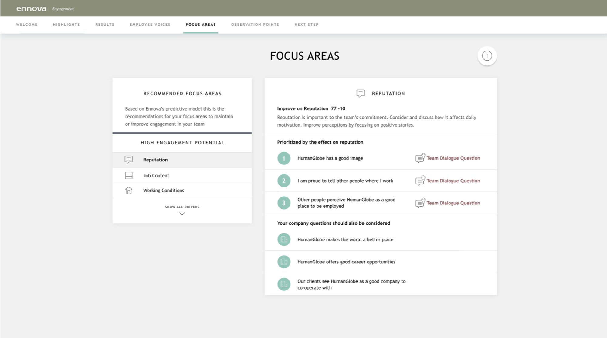
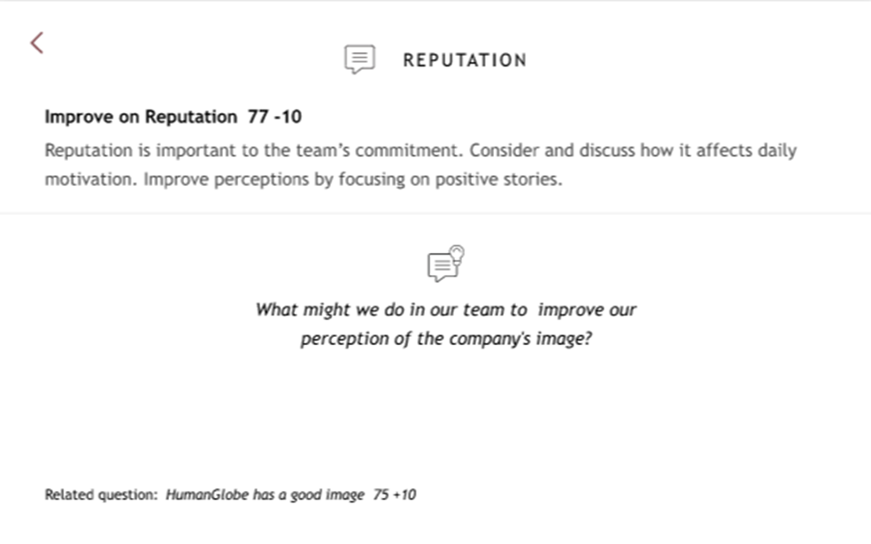
FOCUS AREAS
Only available in team reports.
Get input for the team dialogue by looking at Ennova’s recommended focus areas for your team.
HIGH, MEDIUM & LOW ENGAGEMENT POTENTIAL
The focus area page show all drivers divided into high, medium or low engagement potential. This is done based on three elements:
The employee's evaluation of the driver
The drivers impact on Engagement for the specific group of employees
Ennova big data insights on how easy/difficult it is to improve the driver
The purpose of the recommended focus areas is to give you somewhere to begin your work, so you don’t have to figure out which areas need your attention or in what order.
Notice it’s a recommendation and not a rule book. At the end it’s fully up to you and the team to decide what is most important to work on.
Click on the ‘Team Dialogue Suggestion’ to get inspiration on what to discuss on the coming team dialogue meeting

Slide 14
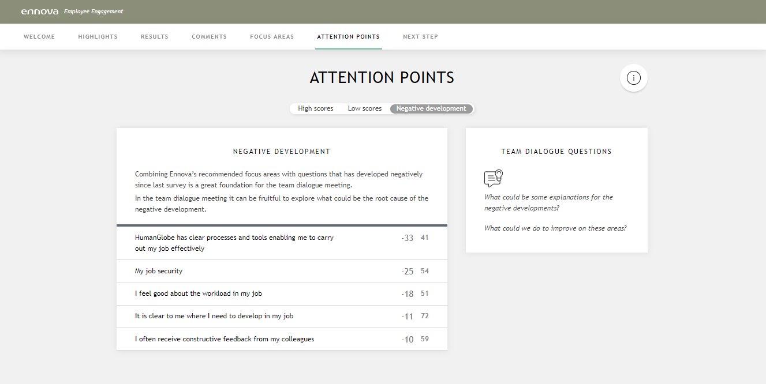
ATTENTION POINTS
Get input for the team dialogue by looking at the Attention points for your team. Dive into high scores, low scores and possible negative development.
Only available in team reports.

Slide 15
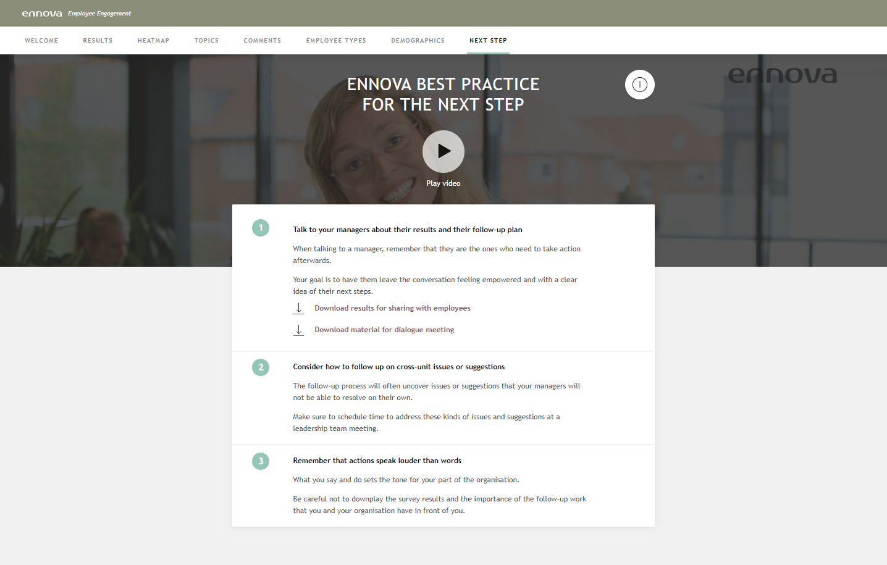
NEXT STEP
Let Ennova’s Leadership & Team Development experts guide you through Ennova’s recommended process for the next steps.
Download PDF with all results, a PDF to facilitate the team dialogue and the possibility to download open comments to a PDF.

