Slide 1


ENNOVA ORGANIZER
User guide to Ennova Organizer
Copyright © by Ennova

Slide 2
Welcome to Ennova Organizer user guide
Your job as validator is to ensure that the information about the organization is correct – you have to validate that the units have the right managers, that the employees in each unit are correct, and that the placement in the Organizer structure is correct.
The validation is important, because if the information in Organizer is not correct the employees get the wrong questionnaires and the managers get wrong reports.

Slide 3
ENNOVA ORGANIZER
WHAT IS ENNOVA ORGANIZER USED FOR?
REPORTING RULES
The information in Organizer forms the basis of the survey – from data collection through analysis to the final reports.
Only respondents (employees) who are registered in Organizer will be included in the survey.
The results of the survey – i.e. the reports – are based on the organizational structure according to the organization in Ennova Organizer.
To ensure reliable results, it is crucial that the information in Ennova Organizer is correct.
Before we can launch the data collection, you will need to validate the entire structure in Organizer.
A unit in Ennova Organizer corresponds to a desired report.
A respondent may be a manager of one or more units.
A manager may not be placed in a unit that he/she manages.
A report consists of the respondents in the folder in which the respondents are placed. If the unit is not at the lowest level in Organizer, the report consists of all respondents in units that are subsidiary to this unit.
Respondents must be at the lowest level. Respondents and units cannot be at the same level
If there are respondents and subsidiary units in the same unit, a new subsidiary unit must be created and the respondents distributed to this unit
Place managers in management groups
Essentially, there must be 4 responses before a report for a unit can be obtained.

Slide 4
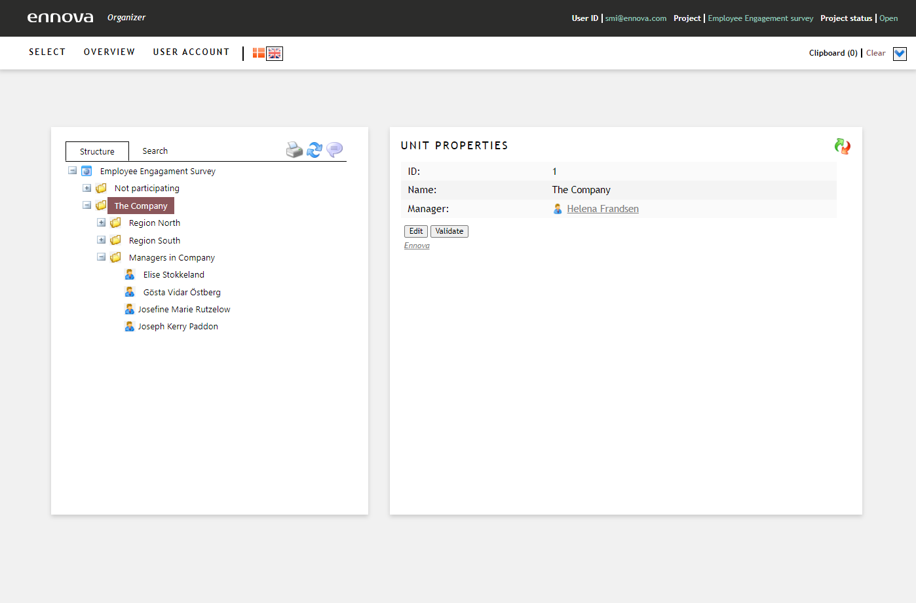
HOW TO NAVIGATE IN ORGANIZER
Click here to find deleted respondents and units
Click here to log out of Ennova Organizer
User name
Project
Status on project
Click here to see the clipboard with units and respondents
If access to multiple structures, please click select to find desired organizational structure
Click here to see where the unit or respondent is placed in the structure
Click on ‘Search’ to find desired respondents or units
Here, you will see the reporting structure
Click on + to expand structure
Click on - to compress structure

Slide 5
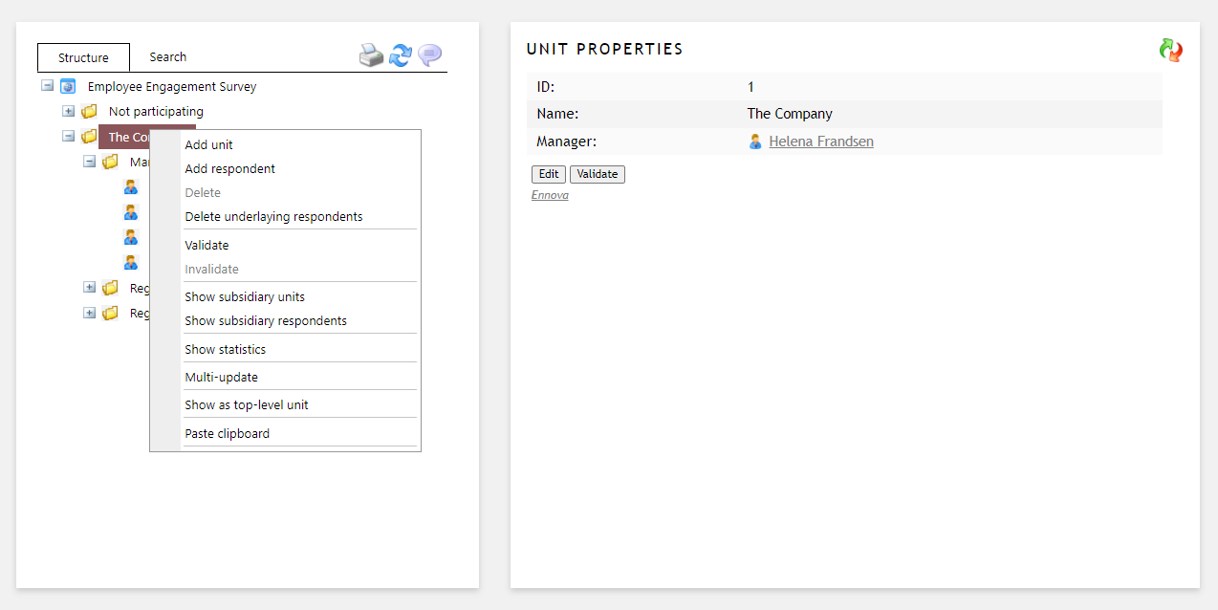
HOW TO NAVIGATE IN ORGANIZER
Unit functionalities
When you select a unit in the structure you will get detailed information about the unit to the right.
Please control that the information is correct.
Click here to show the unit in the structure to the left.
Click on a unit to drag and drop the unit to another place in the structure.
When you have verified the unit information and the respondents, please click ‘Validate’.
Once you validate a unit, the information or respondents in the validated unit cannot be edited.
If you need to make additional changes, please invalidate the unit to proceed.
Right-click on a unit to see a menu with the tools available in Ennova Organizer.
Select ‘show subsidiary units’ for a detailed view of the subsidiary units. You can also correct unit information.
Click ‘Edit’ to edit information on unit.
Please remember to save information before proceeding.
Select ‘show subsidiary respondents’ for a detailed view of the subsidiary respondents. You can also correct respondent information.

Slide 6
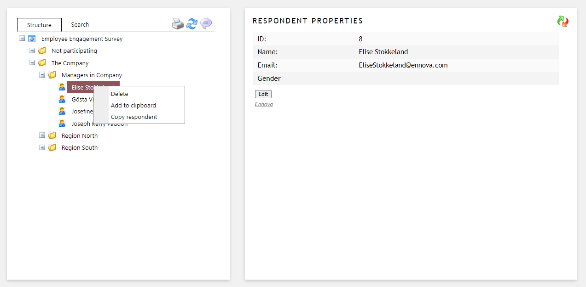
HOW TO NAVIGATE IN ORGANIZER
Respondent functionalities
When you select a respondent in the structure you will get detailed information about the respondent to the right.
Please control that the information is correct.
Click here to show the unit in the structure to the left.
Click on a respondent to drag and drop the respondent to another place in the structure.
Right-click on a respondent to see a menu with the tools available in Ennova Organizer.
Click ‘Edit’ to edit information on unit.
Please remember to save information before proceeding.

Slide 7
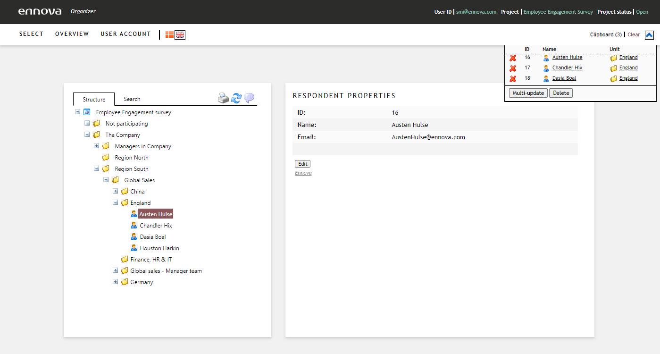
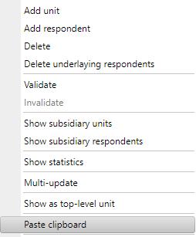
HOW TO NAVIGATE IN ORGANIZER
Clipboard functionality
You can use the clipboard functionality to update properties on several respondents at a time or use the functionality to paste several respondents to a unit at the same time.
Add the respondent to he clipboard by holding down ‘c’ when clicking on the respondents. The respondents then moves to the clipboard automatically. Alternatively, you can right click on the respondent and select ‘Add to clipboard’
Click here to update a respondent property for all selected respondents
Right-click on the unit you want to paste the respondents from the clipboard to and select ‘Paste clipboard’

Slide 8
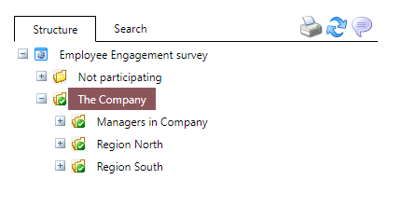
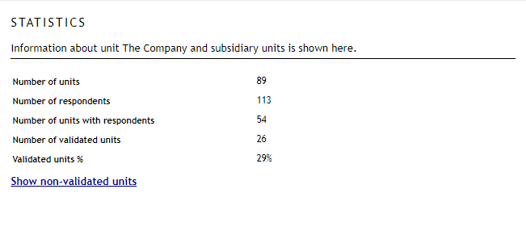
VALIDATION OF YOUR ORGANIZATIONAL DATA
VALIDATION
Once you have ensured that the information about the respondents in a unit and the information about the unit itself are in place, you can click “Validate”. Should the information contain any technical errors, you will see an error message from Organizer.
When you validate a unit, you lock it so that changes cannot be made. This means it is not possible to move respondents from the unit or move new respondents into the unit unless you de-validate the unit.
To ensure good data control, information is always validated from the bottom up (hierarchical validation). This means that you cannot validate a higher unit unless the subsidiary units have also been validated.
If you de-validate a higher unit, the subsidiary units are also de-validated.
SHOW STATISTICS
In the context menu, select “Show statistics”. This gives you a report on the number of units and respondents that have validated from the selected point down.
You can also view the units that have not yet been validated.

